Slide 1
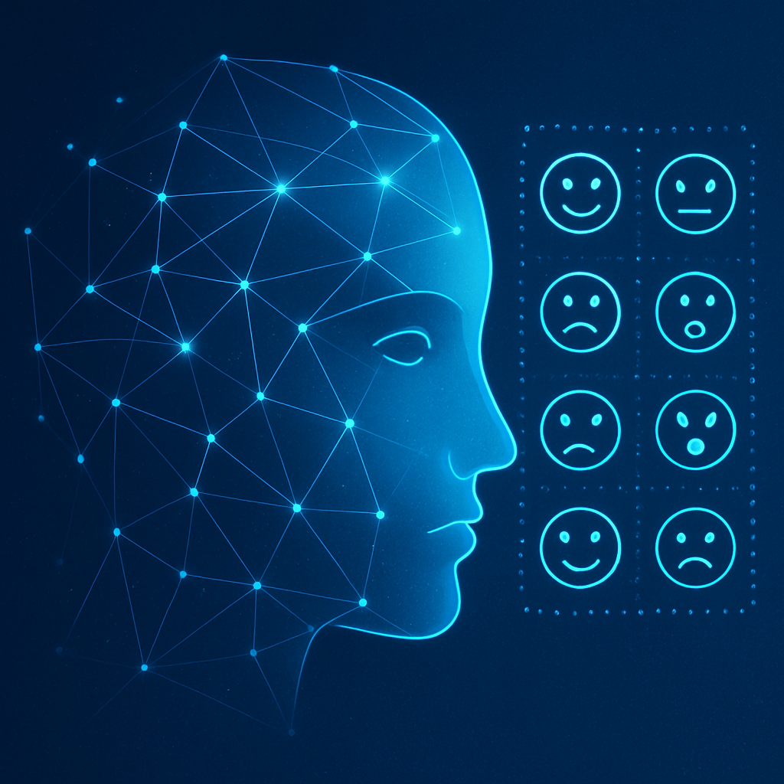
Real‑Time Emotion Classification
using Artificial Neural Networks
COURSE WORK: Artificial Neural Network
M.Sc. Data Science, Coventry University UK (2024.2 Batch)
Lahiru Munasinghe
Index: COMScDS242P-001
[1]

Slide 2

Introduction & Objectives
• Design, train and deploy a neural network for real‑time emotion recognition • Leverage 43,756 grayscale images across six emotion categories • Applications: mental health, robotics, interactive agents, user feedback
[2] [3]

Slide 3

Dataset Preparation
43,756 grayscale face images 6 emotion categories with significant class imbalance (Happy ≈ 30%) Images resized to 48×48 & channels duplicated to RGB Normalization & augmentation for balancing
[4]

Slide 4
Solution Pipeline
EDA & Class Imbalance
Augmentation & Diffusion
Merge & Split Data
Transfer Learning & Fine‑tune
Explainability & Export
Real‑time Inference
Sequential pipeline from data exploration to deployment. Balancing via augmentation & diffusion improves minority class representation. Transfer learning with fine‑tuning yields high accuracy and F1 scores.
[5] [6]

Slide 5
Network Architecture
Input
48×48×1
3‑Channel
48×48×3
ResNet50 Backbone
Dense layers
+ Dropout
Softmax
6 classes
ResNet50 backbone leveraged for feature extraction; custom dense head with dropout reduces overfitting. Grayscale images duplicated to RGB to match pretrained weights.
[7]

Slide 6
Alternative Approaches
Method | Description | Performance
Classical | SVM, HOG features | ~40‑50% accuracy
Scratch CNN | Small CNN trained from scratch | ~60% accuracy
Transfer learning | ResNet50 with fine‑tuning | 70‑80% accuracy
Synthetic aug. | Diffusion‑generated data | Further boosts minority recall
Transfer learning and synthetic augmentation yield the highest performance and robust generalization.
[8] [9]

Slide 7
Model Development & Performance
After augmenting to ~83k images and fine‑tuning in two phases: • Macro F1 score ≈ 0.813 • Stable convergence and minimal overfitting • Minority classes see significant recall improvements
[10]

Slide 8
Optimisation & Hyperparameters
SGD | Stable convergence, simple | Sensitive to learning rate
AdaGrad | Adaptive step sizes | Learning rate decays too much
RMSProp | Handles non-stationary targets | Requires tuning
Adam | Combines advantages of AdaGrad and RMSProp | Can overshoot minima
Learning rate: backbone 1e‑4, head 1e‑3 Batch size: 32 Momentum & weight decay tuned via experimentation
[11]

Slide 9




Mobile Application
Real‑time Detection Camera feed with face detection and on‑device ONNX inference (~15–20 FPS)
Photo Analysis Upload a photo to classify emotion instantly
Image Generation Diffusion model generates expressive faces
XAI Overlay Grad‑CAM & SHAP heatmaps build user trust
Flutter front‑end integrates with ONNX or remote FastAPI server. Modular tabs allow detection, analysis and generation; includes intuitive UI.
[12] [13]

Slide 10
Testing & Validation
Type | Goal
Unit | Validate individual functions & data pipelines
Widget | Ensure UI elements behave correctly
Integration | Test interactions between components
Performance | Measure FPS & inference latency
User Acceptance | Gather feedback from real users
Cross‑platform testing across Android, iOS & web. Continuous integration ensures stability at each development stage.
[14]

Slide 11
Explainable AI
Technique | Pros | Cons
Grad‑CAM | Highlights important regions | Low resolution & biased to last layers
Grad‑CAM++ | Better localization than Grad‑CAM | Higher computational cost
LIME | Model‑agnostic & interpretable locally | Sensitive to perturbations
SHAP | Consistent feature importance | Expensive for deep models
Interactive overlay allows users to toggle explanations and compare methods. Enhances transparency and trust in emotion predictions.
[15] [16]

Slide 12

Generative AI & Transformers
A
B
C
Self‑Attention & Multi‑Head Attention: Tokens attend to every other token with learned weights. Multi‑head attention runs several attention mechanisms in parallel to capture diverse relationships.
Diffusion models generate ~2,634 images to augment minority classes.
[17] [18]

Slide 13
Generative vs Traditional Models
Data Dependency | Requires labeled data | Uses unsupervised / self-supervised
Expressive Power | Limited to training distribution | Can generate novel examples
Compute Needs | Moderate GPU for inference | High compute during training
Interpretability | Relatively straightforward | Less interpretable, needs XAI
Safety & Ethics | Lower risk | Misuse risk & biases
Generative methods complement discriminative neural networks by enriching data, enabling cross‑modal tasks and fostering creativity.
[19] [20]

Slide 14

Conclusion & Impact
A robust real‑time emotion classifier built on transfer learning achieves macro F1 ≈ 0.813. Open‑source Flutter app enables accessible emotion recognition and explainability on mobile devices. Generative augmentation and XAI techniques improve minority class recall and build user trust. Future work: cross‑modal emotion recognition, personalised feedback systems, ethical considerations.
[21] [22]

